Slide 1
Objectives
MATH 1010K Notes – Section 8.2
Graphing Linear Equations with Points
Determine ordered pairs and graph a linear equation in two variables.
Find the x-and y-intercepts of the graph of a linear equation.
Find the slope of a non-vertical line given two points on the line.
Graph a line given its slope and a point on the line.
Interpret slope as average rate of change.
Determine the graph of an equation of a line in slope-intercept form.
Graph a line if given an equation of a line in slope-intercept form.
Find an equation of a line in slope-intercept form, if given: (a) the slope and one point; or (b) two points
Use the slope-intercept form to graph the line from the equation.

Slide 2
Linear Equation in Two Variables
An equation that can be written in the form
Ax + By = C (where A and B are not both 0)
is a linear equation in two variables. This form is called standard form.
A linear equation in two variables will have solutions written as ordered pairs. In general, these equations will have an infinite number of solutions.
All first-degree equations with two variables (both x and y have an exponent of 1) have straight-line graphs.

Slide 3
Intercepts
The x-intercept is the point (if any) where the line crosses the x-axis, and the y-intercept is the point (if any) where the line crosses the y-axis.
To find the x-intercept of the graph of a linear equation, set y = 0 and solve for x.
To find the y-intercept, set x = 0 and solve for y.

Slide 4
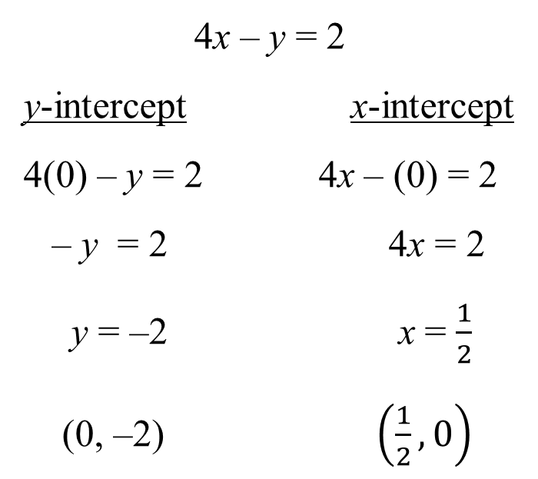
Example: Graphing an Equation Using Intercepts
Find the x- and y-intercepts of 4x – y = 2 and graph the equation.
Solution
Although you can inspect the graph to determine the x- and y-intercepts, if you have the actual equation, it is BEST to substitute zero into the equation.
y
4x – y = 2
y-intercept x-intercept
4(0) – y = 2 4x – (0) = 2
– y = 2 4x = 2
y = –2 x = $\frac{1}{2}$
(0, –2) $\left(\frac{1}{2},0\right)$
x
0
(0, –2)

Slide 5
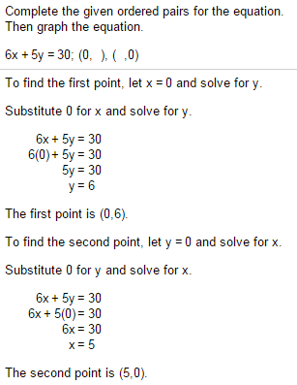
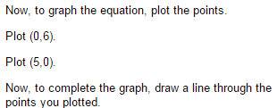
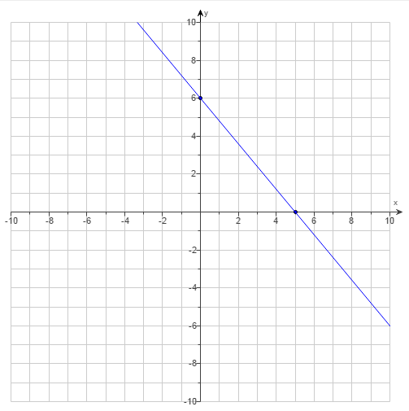
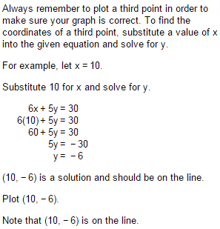
Example from MyMathLab

Slide 6
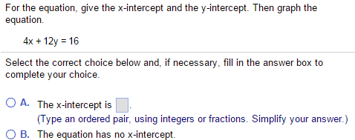
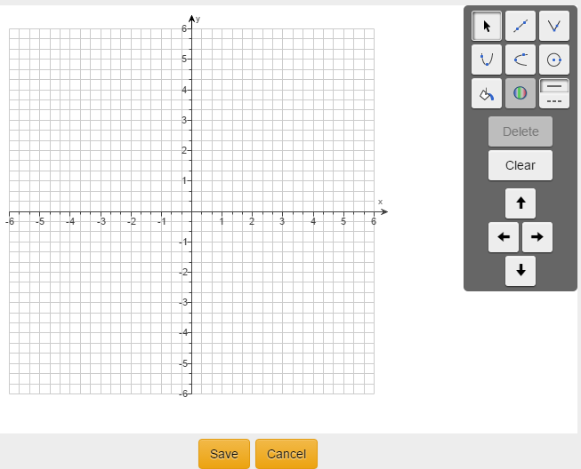
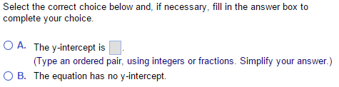
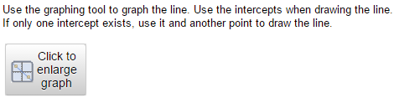
Example from MyMathLab

Slide 7
Graphing a Line Using Points other than Intercepts
If you have an equation of a line, you can generate points for that line.
As long as you know one of the coordinates, then you can find the other.
This can be done using a table.
You can pick your own x-coordinate and then find the y-coordinate that goes with it.
Or…you can go in reverse – you can pick the y-coordinate and find the x-coordinate that goes with it.
The next example from MyMathLab demonstrates this idea..

Slide 8
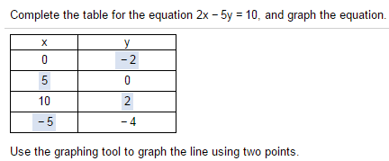
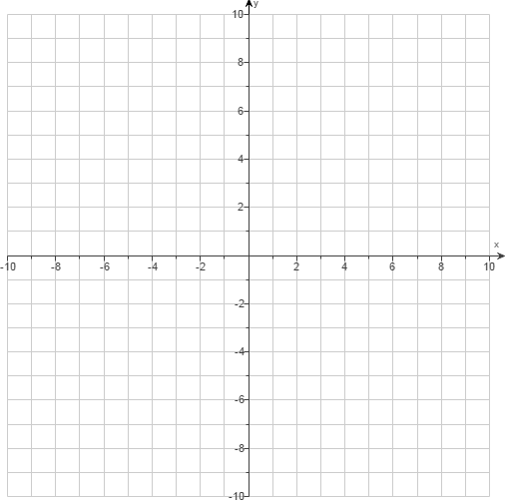
Example from MyMathLab

Slide 9
Example: Graphing with a Single Intercept
Graph y = 3.
Solution
You simply graph a line through (perpendicular to) the y-axis at the point 3. That’s it.
y
y = 3
x
0

Slide 10
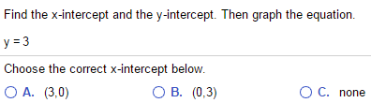
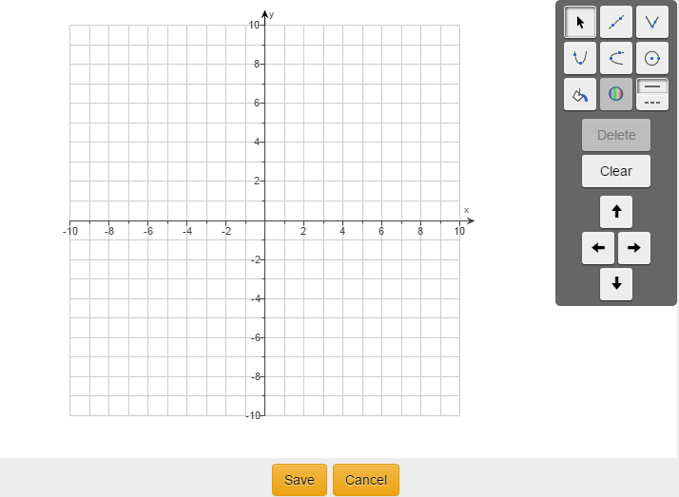

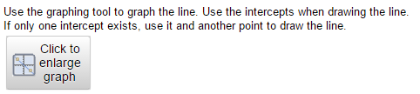
Example from MyMathLab

Slide 11

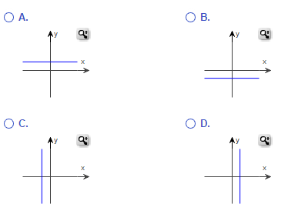
Example from MyMathLab

Slide 12
Example: Graphing with a Single Intercept
Graph x = –2.
x = –2
Solution
You simply graph a line through (perpendicular to) the x-axis at the point –2. That’s it.
y
x
0

Slide 13
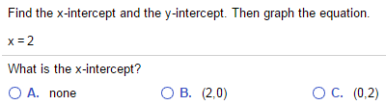
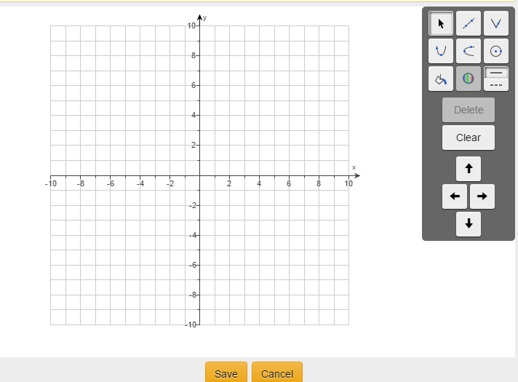

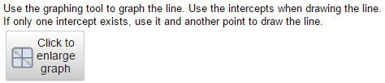
Example from MyMathLab

Slide 14
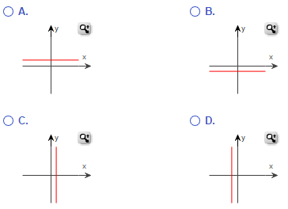

Example from MyMathLab

Slide 15
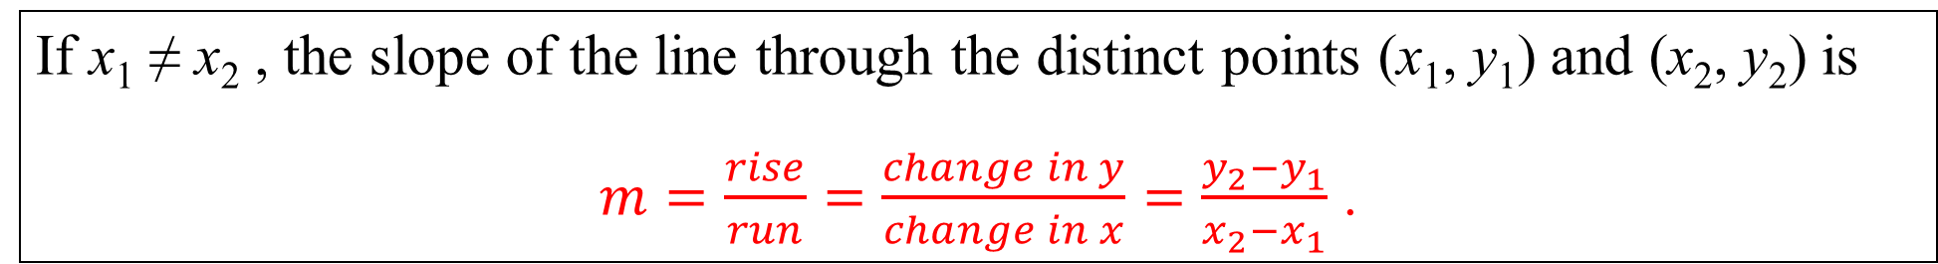
Slope
The measure of the steepness of a line is called the slope of the line. One way to get a measure of the steepness of a line is to compare the vertical change in the line (the rise) to the horizontal change (the run) while moving from one fixed point to another.
If x₁ ≠ x₂ , the slope of the line through the distinct points (x₁, y₁) and (x₂, y₂) is
$m=\frac{rise}{run}=\frac{change in y}{change in x}=\frac{y_{2}−y_{1}}{x_{2}−x_{1}}$ .

Slide 16
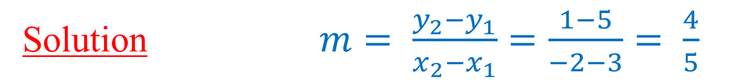
Example: Using the Slope Formula
Find the slope of the line that passes through the points (3, 5) and (–2, 1).
Solution$m= \frac{y_{2}−y_{1}}{x_{2}−x_{1}}=\frac{1−5}{−2−3}= \frac{4}{5}$
Vertical and Horizontal Lines
Up-and-down line is undefined.
A vertical line has an equation of the form x = a, where a is a real number, and its slope is undefined.
A horizontal line has an equation of the form y = b, where b is a real number, and its slope is 0.
HoriZontal line makes Zero.

Slide 17
Example: Graph a Line Using Slope and a Point
Graph the line that has slope and passes through (–1, 1).
Solution
Right 3
Up 2
(–1, 1)
0
x
y

Slide 18
Positive and Negative Slopes
A line with a positive slope rises from left to right, while a line with a negative slope falls from left to right.
Negative slope
y
Positive slope
Zero slope
x
0
Undefined slope

Slide 19
Average Rate of Change
The slope of a line is the ratio of the change in y (vertical change) to the change in x (horizontal change). This idea can be extended to real-life situations as follows: the slope gives an average rate of change of y per unit change in x, where the value of y is dependent on the value of x.

Slide 20
Example: Finding the Average Rate of Change
If a computer was worth $2000 in the year 2004 and only $800 in 2007, find the average rate of change in the value of the computer over the 3 years.
Solution
Determine the slope of the line segment between the points (2004, 2000) and (2007, 800).
The value dropped by about $400 per year.

Slide 21
Slope-Intercept Form
The equation of the line with slope m and y-intercept (0, b) is written in slope-intercept form as
Slope
y-intercept

Slide 22
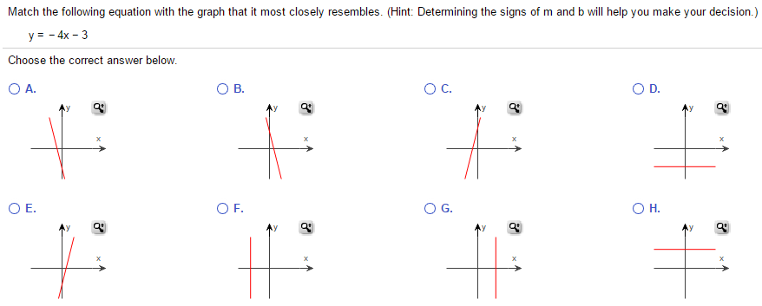
An Example from MyMathLab

Slide 23

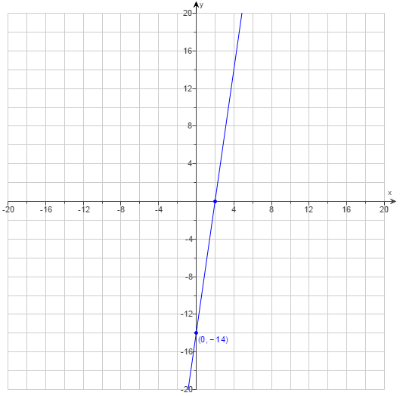

An Example from MyMathLab

Slide 24


Example: Finding an Equation Given the Slope and a Point
Find the slope-intercept form of an equation of the line with slope 1/3, passing through the point (–3, 2).
Solution
The given point (x, y) is (–3, 2) and m = $\frac{1}{3}$
Use the slope-intercept formula, y = m x + b
2 = $\frac{1}{3}$ (–3) + b
2 = –1 + b
3 = b
Once you know your m and your b, you make the equation, based on y = m x + b
y = $\frac{1}{3}$x + 3

Slide 25
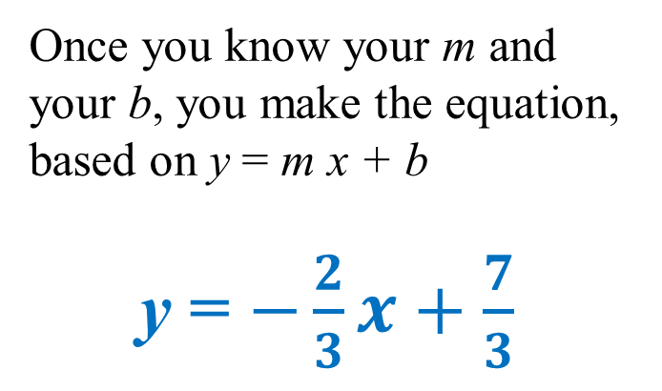
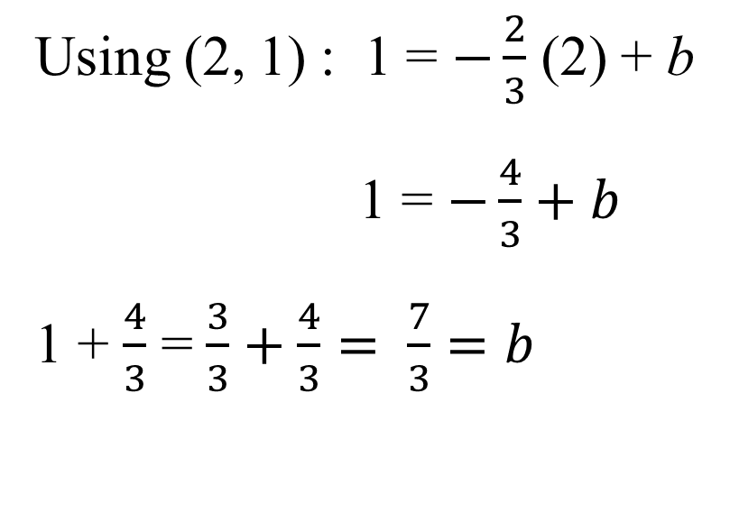
Example: Finding an Equation Given Two Points
Find the slope-intercept form of an equation of the line passing through the points (2, 1) and (–1, 3).
Solution
First, find the slope, $m=\frac{y_{2}−y_{1}}{x_{2}−x_{1}}= \frac{3−1}{−1−2}=\frac{2}{−3}=−\frac{2}{3}$
Use either point (x, y) with slope-intercept form y = m x + b
Using (2, 1) : 1 = $−\frac{2}{3}$ (2) + b
1 = $−\frac{4}{3}+b$
1 + $\frac{4}{3}$ = $\frac{3}{3}+\frac{4}{3}= \frac{7}{3}=b$
Once you know your m and your b, you make the equation, based on y = m x + b
y = $−\frac{2}{3}x+\frac{7}{3}$

Slide 26
Example: Graphing a Line Using Slope and the y-Intercept
Graph the line with equation
y
Solution
Plot the y-intercept (0, –2) and use the slope: rise 3, run 2.
run 2
x
rise 3
(0, –2)

Slide 27
Summary of Forms of Linear Equations
Ax + By = C Standard form
x = a Vertical line
y = b Horizontal line
y = mx + b Slope-intercept form
y – y₁ = m(x – x₁) Point-Slope form

